Slide 1
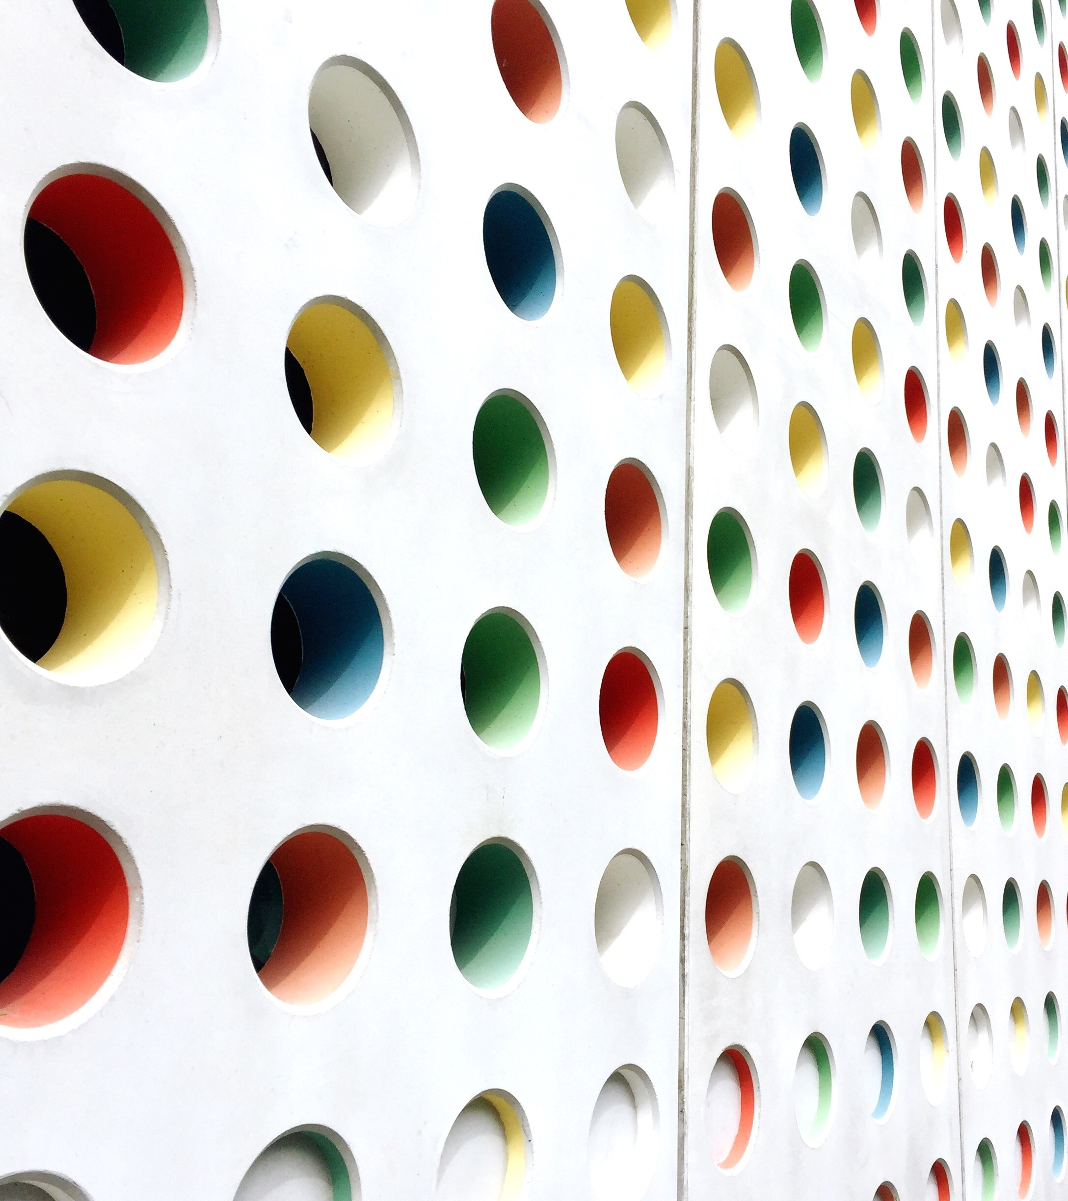
News Updates
Team members:
2010030046-e.pravallika
2010030168-Tahseen begum
2010030344-sowgna reddy
2010030445-P.keerthana

Slide 2
Table Contents
Abstract
Project Area
Literature Survey
Problem Statement
Conclusion
Suggestions
Thank you

Slide 3
Abstract
Today the world totally relies upon electronic media for its everyday adventure. People have no time to be updated through Newspapers or watch or listen to the news on television or radios. The WWW (World Wide Web) is a huge, widely distributed, global information service center for Information services: news, advertisements, consumer information, financial management, education, government, e-commerce, etc. “24 Hours News Portal” is a service introduced to meet the above requirement and to make the people updated about the news, views, reviews, breaking news and latest headlines in different fields also the new inventions around the world.

Slide 4
Project Area
Natural language processing (NLP) refers back to the branch of laptop science—and more specifically, the branch of synthetic intelligence or AI—concerned with giving computers the capability to understand textual content and spoken phrases in lots the equal way human beings can.

Slide 5
Literature Survey
s/no | Title | Authors | Publishing | Characteristics | Pros
1. | Designing resilient organic greenhouse production systems for Europe: updates from the first half of the GREENRESILIENT project | Tittarelli, Fabio | 2020 | Differences in soil health and functional biodiversity are evaluated in the BAU and INN cropping systems, within each experimental site, by studying bacterial, fungal and nematode community composition in soil samples as well as insect and weed communities.The total baseline number of nematodes and nematode genera varied between the different sites.Several strains of insect parasitic fungi were successfully isolated from the five experimental sites and the highest diversity was found in Italy and France, followed by Switzerland, Belgium and Denmark. | Growers, policy makers and the general public had a chance to learn more about these developments and see the experimental sites at Open House events, which will be repeated during the upcoming growing season.

Slide 6
Literature Survey
s/no | Title | Author | Publishing | Characteristics | Pros
2. | News and Updates from the leading pioneer for nanotechnology solutions | Ponnath, Florian ; Gragnaniello, Luca ; Gokus, Tobias | 2021 | Our technical experts will bring you up to speed on our current product portfolio and provide an in-depth look at new products and innovations. attocube has been a leading nanotechnology solutions pioneer for 20 years, delivering cutting edge components and systems for precision motion & sensing, cryogenic microscopy, and nanoscale analytics. | Cryogenic Instruments offers nanoscale cryogenic measurement instrumentation based on low vibration closed-cycle cryostats, cryo-optical tables and a wide range of low & ultra-low temperature as well as high magnetic field compatible measurement inserts allowing for research techniques such as AFM, MFM, confocal & RAMAN microscopy as well as electric and photonic transport measurements.

Slide 7
Literature Survey
s/no | Title | Author | Publishing | Characteristics | Pros
3. | A comprehensive update on valvular heart disease: from mechanisms to Guidelines | European Heart Journal, Volume 43, Issue 7, 14 | February 2022, Pages 545–549 | the choice of the mode of intervention, current evidence reinforces the critical role of the Heart Team, which should integrate clinical, anatomical, and procedural characteristics beyond conventional scores, and informed patient’s treatment choice. Regarding surgery, increasing experience and procedural safety has led to expansion of indications toward earlier intervention in asymptomatic patients with aortic stenosis, aortic regurgitation, or mitral regurgitation (MR), and now stress the preference for valve repair when it is expected to be durable. | by proposing TRI-SCORE as a dedicated risk score model based on eight easy to ascertain parameters to inform patients and physicians regarding the risk of ITVS and guide the clinical decision-making process of patients with severe TR, especially as transcatheter therapies are emergency.

Slide 8
Literature Survey
s/no | Title | Author | Publishing | Characteristics | Pros
4. | Fake news detection based on statement conflict | Danchen Zhang, Jiawei Xu, Vladimir Zadorozhny & John Grant | Journal of Intelligent Information Systems (2022 | We propose two models: the first one uses only the agree and disagree classifications; the second uses a subjective opinions based model that can also handle the uncertain cases. Our experiments on a real-world dataset (the Fake News Challenge 1 dataset) and a simulated dataset validate that both proposed models achieve state-of-the-art performance. | Using this information, we focus on selecting the news articles that are most likely to be fake.

Slide 9
Problem Statement
Social media is a useful tool for staying updated about current events and new ideas. You can receive stories in real-time, engage with other users, and share content that interests you. A news update project can involve collating weekly insights on the latest happenings from different social media platforms.
Nowadays, almost every news and media company has a social media page that you can follow to get live updates. You can also follow eminent personalities, politicians, and celebrities.

Slide 10
Conclusion
News will be throughout the day and keep you updated. It covers in-depth reporting of the current happenings in the Country. News sites offer information to the public, political, social, sports, health, entertainment, etc. Instant & latest news from all over the world country.

Slide 11
Suggestions

Slide 12
Thank You

